Slide 1
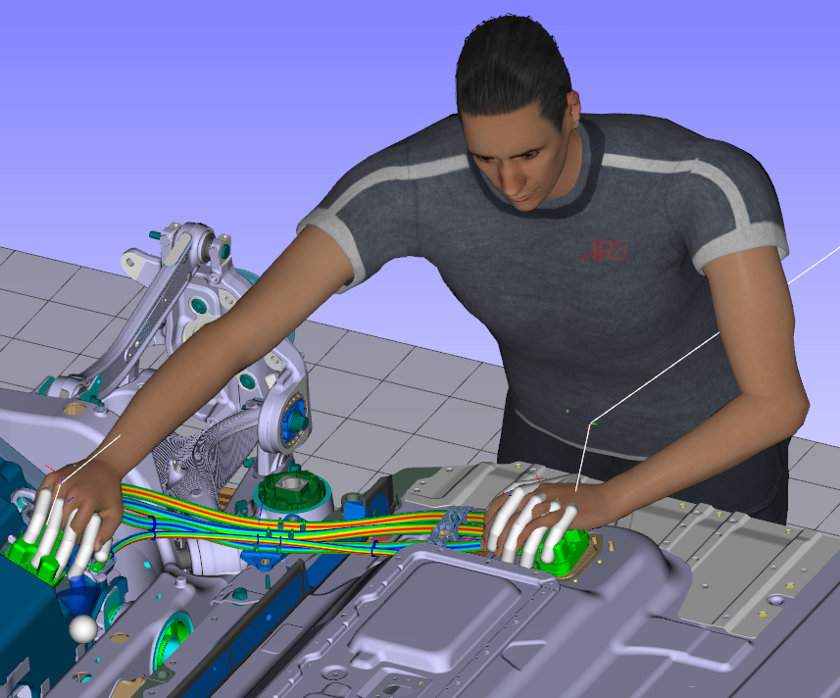
EWASS
Status MEETING
18 FEB 2025
WP 2
Ergonomics Assessment
University of Skövde
Dan Högberg
Aitor Iriondo Pascual
Mikael Lebram

Slide 2
EWASS WP 2 – ergonomicS assessment
Objective
To develop a demonstrator solution for the assessment of forces acting on digital human models during simulation of assembly of electrical cables and wire harnesses.
Aim
To provide engineers with a better understanding of whether a simulated assembly work situation is ok for the intended worker population in regard to force exertion, or if there are risks for musculoskeletal disorders (MSDs), and hence a need for re-design of some sort (i.e. a proactive ergonomics approach).

Slide 3
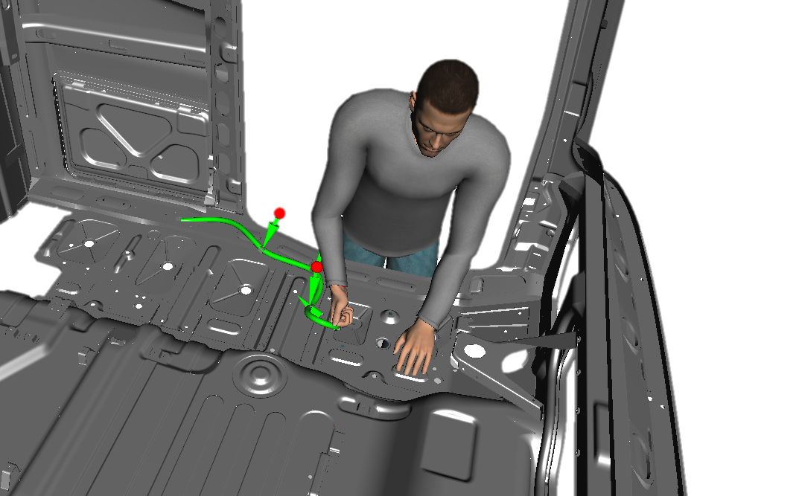
EWASS WP 2 – ergonomicS assessment
Our approach (together with FCC):
Compute forces and torques by simulating the work in IPS IMMA (the “Demand”)
Compare those forces with max forces according to established methods (the “Capacity”)
Draw conclusions based on the Demand/Capacity ratio for certain populations

Slide 4
EWASS WP 2 – ergonomicS assessment
Demand
The force demanded to perform the work tasks. Forces are derived by simulating the physics in IPS IMMA.
Capacity
The max acceptable force for a given percentage of the population, for the characteristics of the work task (posture, force direction, frequency …).
Demand
Capacity

Slide 5
IPS IMMA
Forces/Torques
Force/torque evaluation
LUA script export
Platform for ergonomics evaluation methods (PEM)
LUA script export
Posture evaluation
Posture

Slide 6
METHOD 1: CAPACITY ACCORDING TO THE Arm Force Field (AFF) METHOD
Strength percentile
Gender
Predicted manual arm strength for X% of the population.
For each hand.
Force exerted in the middle of the hand.
Force direction
Arm Force Field (AFF) method
Using Artificial Neural Network (ANN)
Hand location
Torso orientation
Frequency & Duration
Nicholas J. La Delfa, Jim R. Potvin, The ‘Arm Force Field’ method to predict manual arm strength based on only hand location and force direction, Applied Ergonomics, Volume 59, Part A, 2017, Pages 410-421

Slide 7
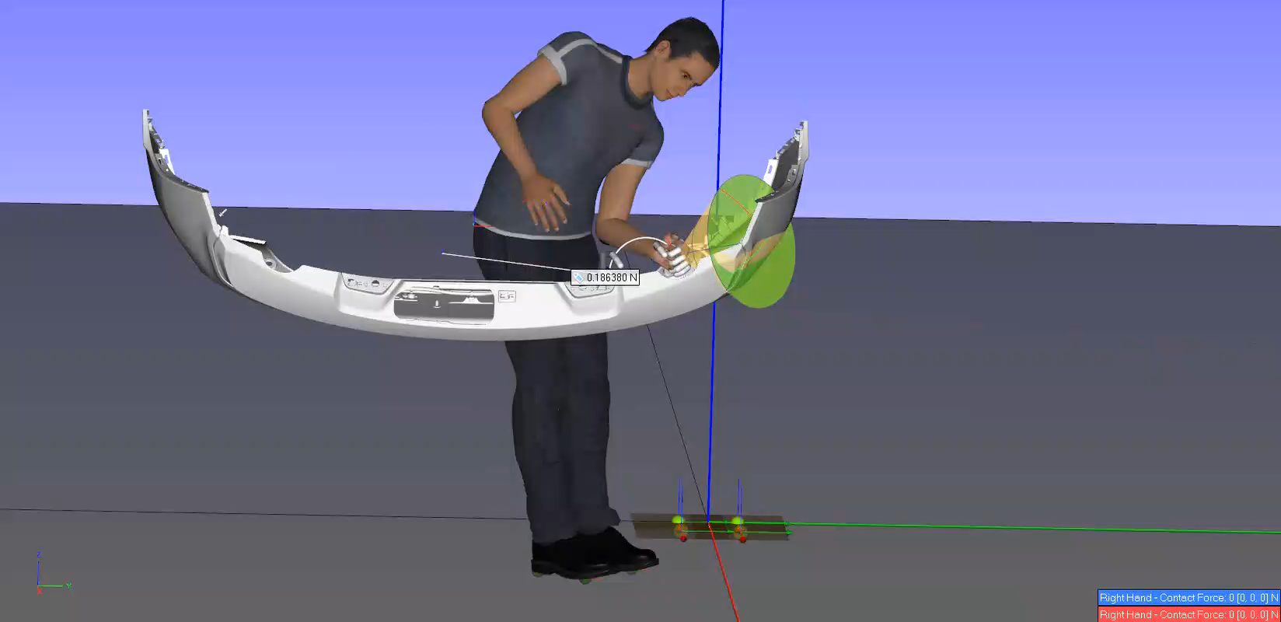
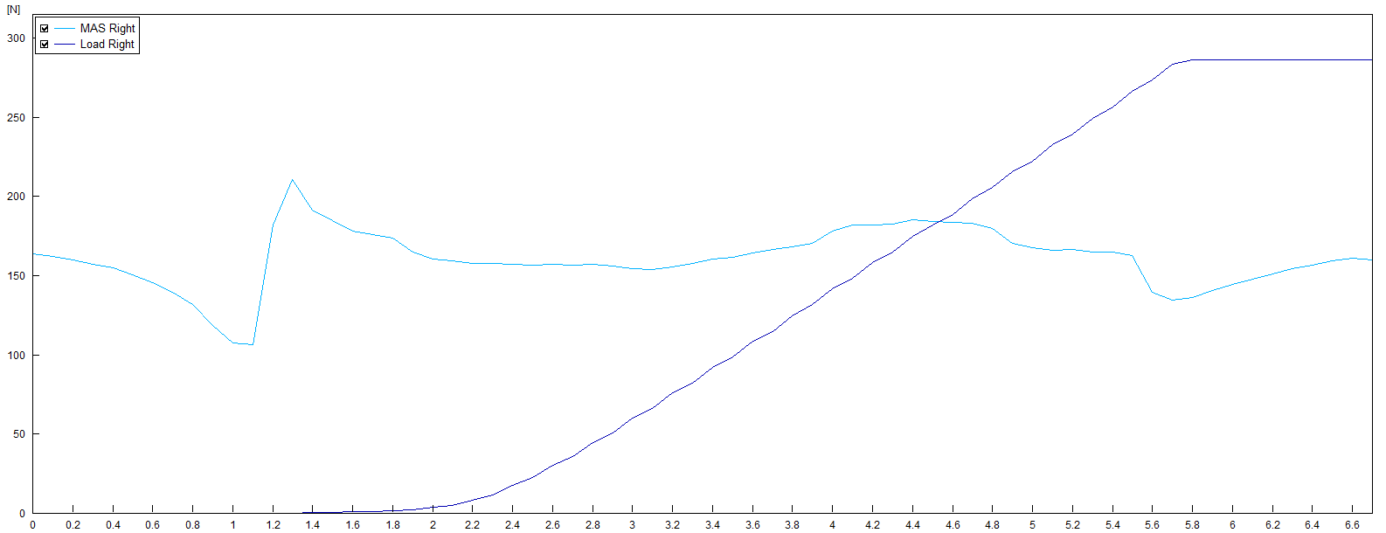
Initial test

Slide 8
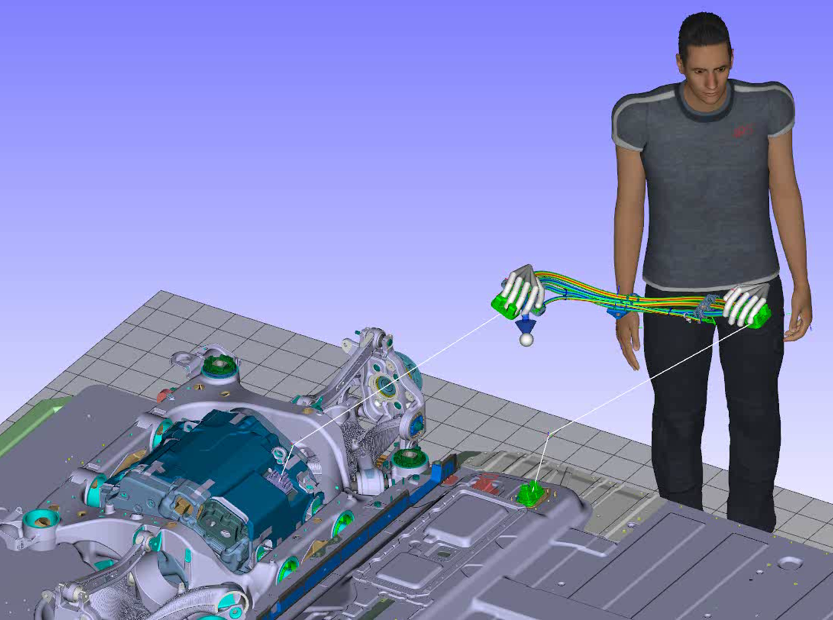
Use Case: VCC Case 2 – HV Battery to ERAD assembly
Assembly steps
Reach for object
Grasp object (gravitational force)
Move object (gravitational force)
Manipulate object (gravitational force and force due to elastic deformation of object)
Apply assembly force (e.g. connectors/clips force, manual input)

Slide 9


Slide 10
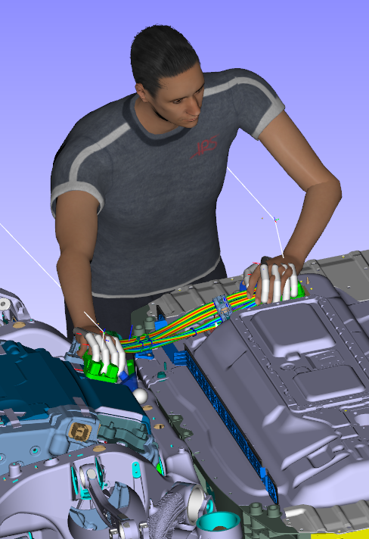
Limiting factor can be arm or hand force capacity.
Forces from both cable weight, cable flexing and mounting connectors/clips.
Connector/clips mounting forces not represented in simulation (manual input).

Slide 11
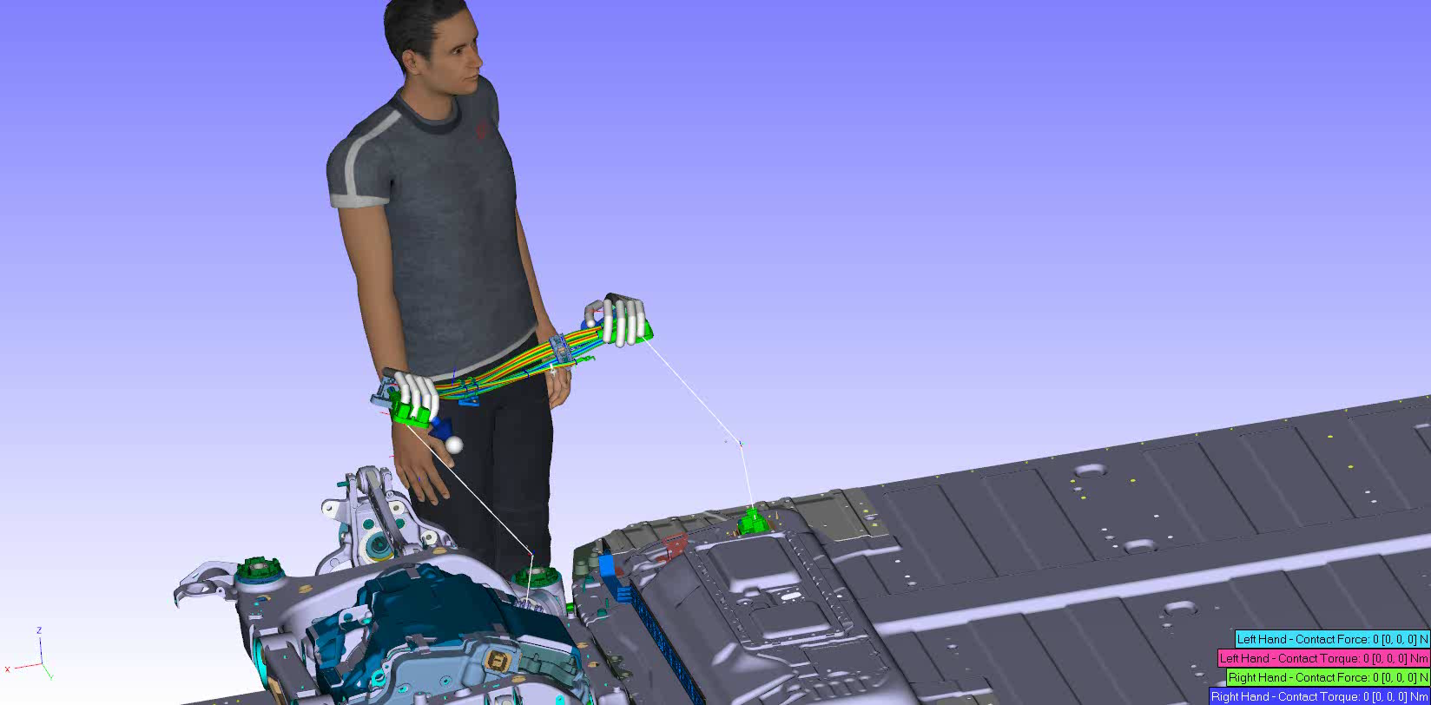
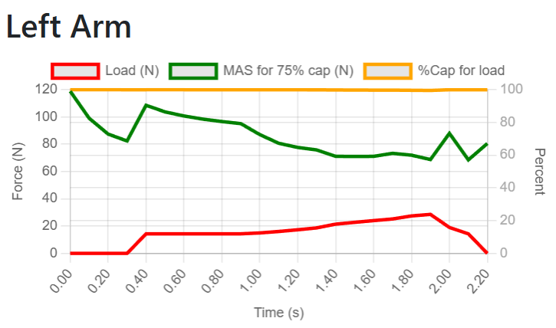
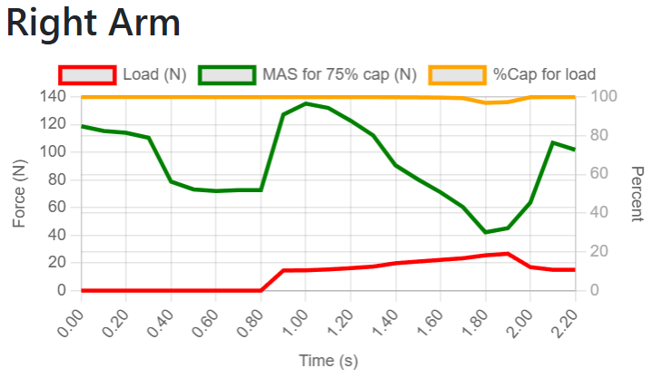
Comparison of force demand (red curve) with human force capacity (green curve) using the Arm Force Field (AFF) method in PEM.
MAS = Manual Arm Strength (i.e. not considering frequency and duration).
MAF = Max Acceptable Force (i.e. with consideration of frequency and duration, can also be calculated)
Orange curve shown percentage capable at each instance of the assembly sequence.
(force from mounting connector/clips not considered)

Slide 12
Concurrent force and posture assessment

Slide 13
METHOD 2: CAPACITY ACCORDING TO THE HANDPAK METHODS PACKAGE
https://potvinbiomechanics.com/handpak/

Slide 14
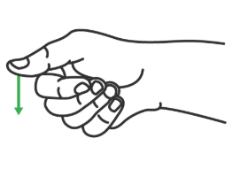
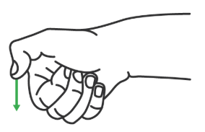
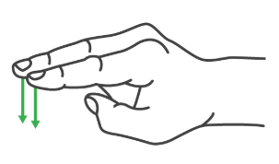
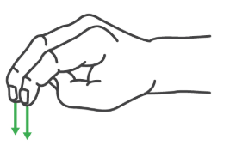
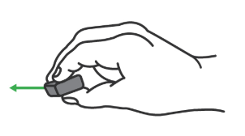
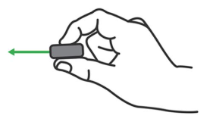
Hand force can be the limiting factor depending on the design.
Assuming once per minute during a workday.
75% female capable.
Worst/best depends on:
Wrist posture.
Distance between fingers.
Wrist flexion/extension angle.
Wrist ulnar/radial angle.
68.5 - 80.9 N
51.3 – 60.5 N
68.5 – 89.1 N
53.9 – 63.7 N
≈10.3 - 47.5 N
≈8.5 – 40.7 N

Slide 15
COMING RESEARCH ACTIVITIES
Focus on the assessment on forces towards the end of the simulated assembly sequence (mounting the flexible object, e.g. with electric connectors and clips).
Implementing (some of the methods of) HandPak in PEM.
Assessment of hand forces (in addition to AFF and posture methods).

Slide 16
PUBLICATIONS IN PROGRESS
Iriondo Pascual, A., Holm, M., Ng, A., Larsson, F., Olsson, J. (2025). Integrating motion capture and digital human modelling tools for evaluating worker ergonomics - A case study in a medium size enterprise assembly station. Submitted to HCII2025, Gothenburg, Sweden, 22 - 27 June 2025.
Iriondo Pascual, A., Högberg, D., Lebram, M., Mårdberg,P., Spensieri, D., Lämkull, D. (2025). Assessment of Manual Forces in Assembly of Flexible Objects by the Use of a Digital Human Modelling Tool – a Use Case. Abstract submitted to DHM2025, Loughborough, UK, 29 - 31 July 2025.
Högberg, D., Iriondo Pascual, A., Lebram, M. (2025). Initial Comparison of Recommended Force Limits Given by the Assembly Specific Force Atlas and the Arm Force Field Method. Abstract submitted to DHM2025, Loughborough, UK, 29 - 31 July 2025.

